Slide 1


E-commerce Customer Churn Analysis using SQL And Power BI
SQL Code link
Dashboard link

Slide 2
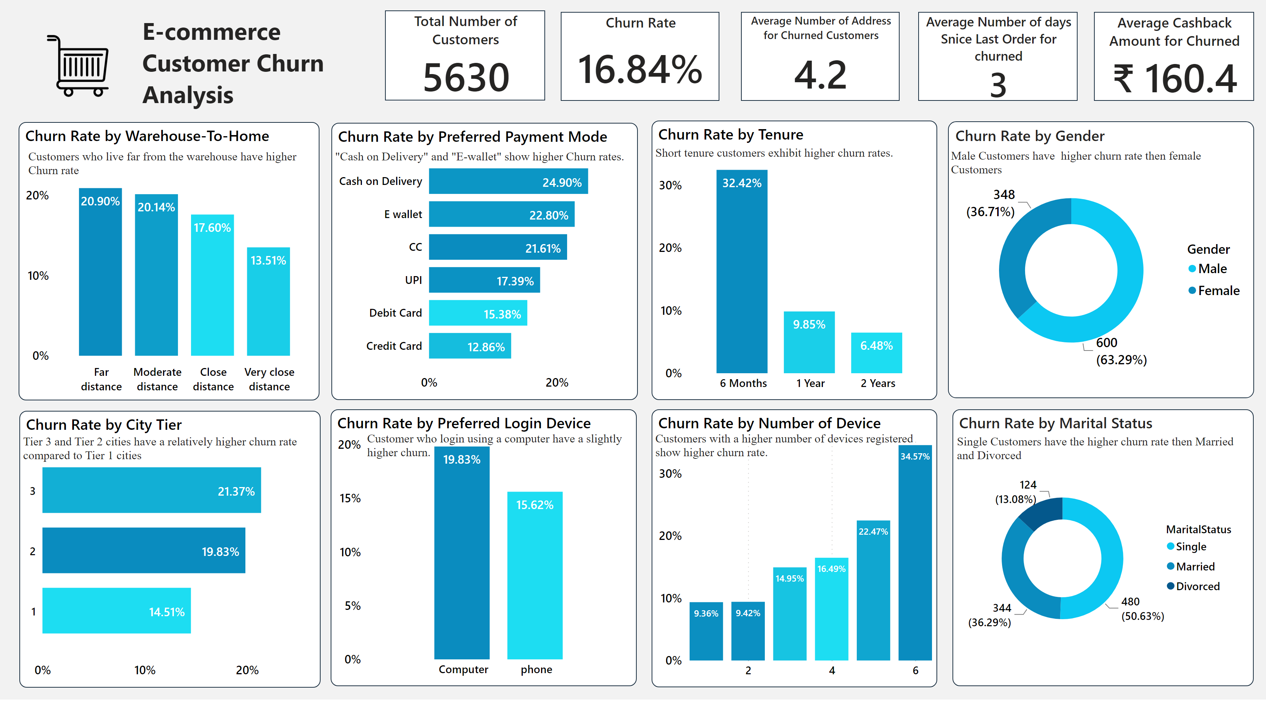
E-commerce Customer Churn Analysis
Notes:
Total Number of Customers
No alt text provided
Churn Rate
No alt text provided
Churn Rate by Preferred Payment Mode
No alt text provided
Churn Rate by Tenure
No alt text provided
Churn Rate by City Tier
No alt text provided
Churn Rate by Preferred Login Device
No alt text provided
Churn Rate by Number of Device
No alt text provided
Average Number of days Snice Last Order for churned
No alt text provided
Average Number of Address for Churned Customers
No alt text provided
Average Cashback Amount for Churned
No alt text provided
Churn Rate by Gender
No alt text provided
Churn Rate by Marital Status
No alt text provided
textbox
No alt text provided
Churn Rate by Warehouse-To-Home
No alt text provided
textbox
No alt text provided
textbox
No alt text provided
textbox
No alt text provided
textbox
No alt text provided
textbox
No alt text provided
textbox
No alt text provided
textbox
No alt text provided
image
No alt text provided
textbox
No alt text provided

Slide 3
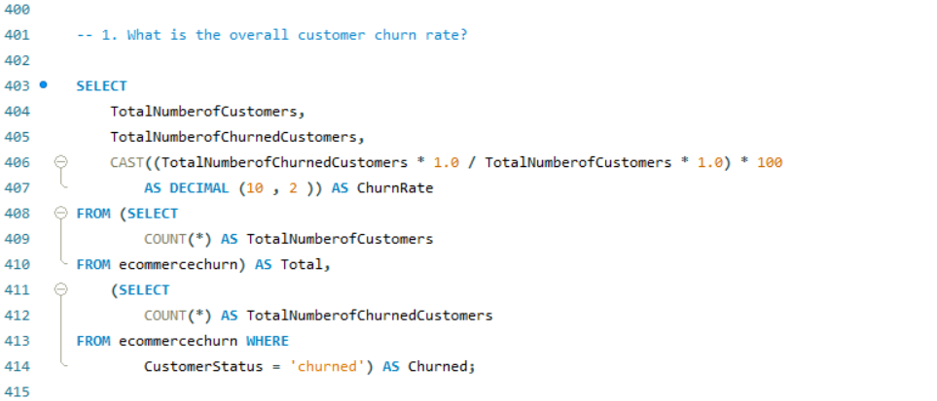
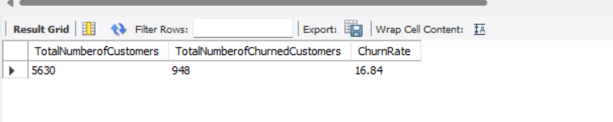
Q1. What is the overall customer churn rate?
The churn rate of 16.84% indicates that a significant portion of customers in the dataset have ended their association with the company.

Slide 4
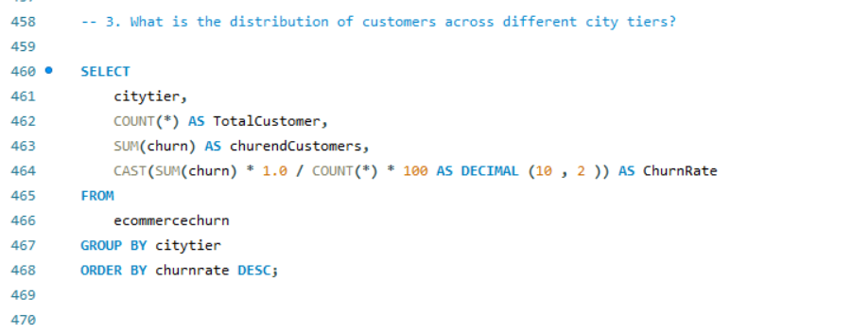
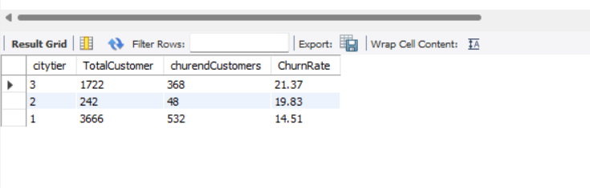
Q2. What is the distribution of customers across different city tiers?
The result suggests that the city tier has an impact on customer churn rates. Tier 1 cities have a relatively lower churn rate compared to Tier 2 and Tier 3 cities.
This could be attributed to various factors such as competition, customer preferences, or the availability of alternatives in different city tiers.

Slide 5
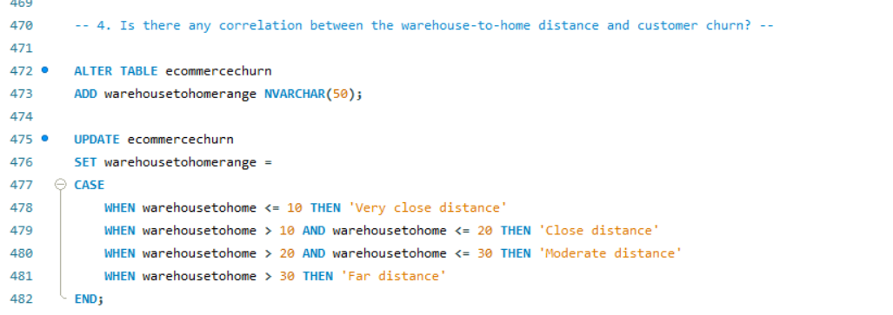
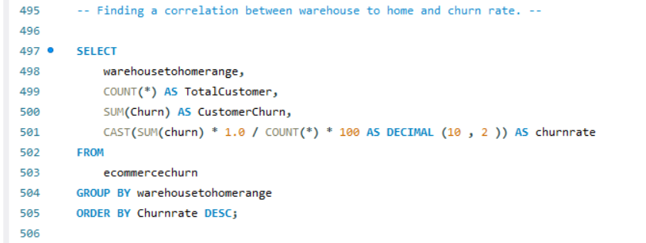
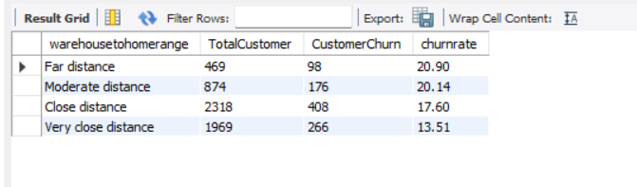
Q3. Is there any correlation between the warehouse-to-home distance and customer churn?
In order to answer this question, we will create a new column called “WarehouseToHomeRange” that groups the distance into very close, close, moderate, and far using the CASE statement.
The distance between the warehouse and the customer’s home seems to have some influence on customer churn rates. Customers residing in closer proximity to the warehouse tend to have lower churn rates, while customers living at further distances are more likely to churn.
This suggests that factors such as delivery times, shipping costs, or convenience may play a role in customer retention.

Slide 6
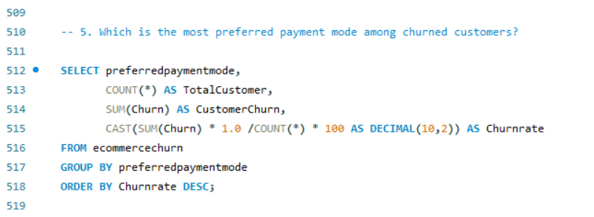
Q4. Which is the most preferred payment mode among churned customers?
The most preferred payment mode among churned customers is cash on delivery.
The preferred payment mode seems to have some influence on customer churn rates. Payment modes such as “Cash on Delivery” and “E-wallet” show higher churn rates, indicating that customers using these payment modes are more likely to churn.
On the other hand, payment modes like “Credit Card” and “Debit Card” have relatively lower churn rates.

Slide 7
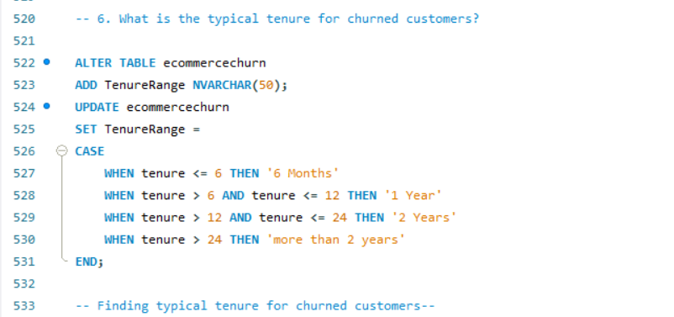
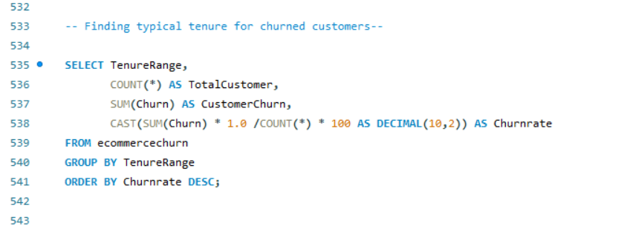
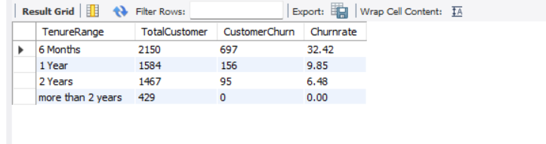
Q5.What is the typical tenure for churned customers?
First, we will create a new column called “TenureRange” that groups the customer tenure into 6 months, 1 year, 2 years, and more than 2 years using the CASE statement.
This shows that customers who have been with the company for longer periods, specifically more than 2 years in this case, have shown a lower likelihood of churn compared to customers in shorter tenure groups.

Slide 8
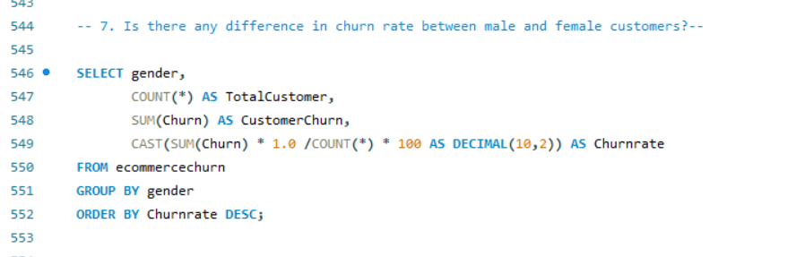
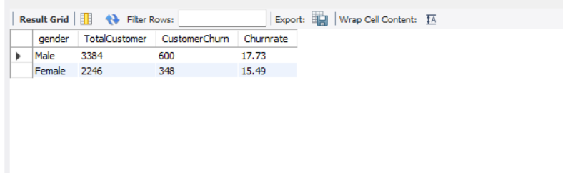
Q6.Is there any difference in churn rate between male and female customers?
Both male and female customers exhibit churn rates, with males having a slightly higher churn rate compared to females.
However, the difference in churn rates between the genders is relatively small.
This suggests that gender alone may not be a significant factor in predicting customer churn.

Slide 9
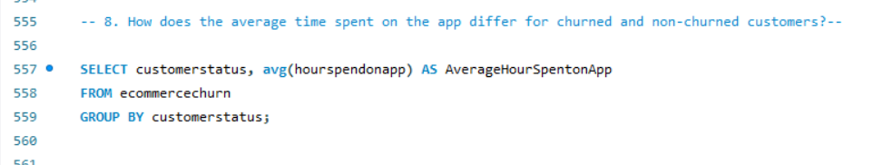
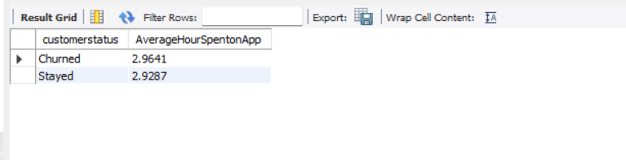
Q7.How does the average time spent on the app differ for churned and non-churned customers?
Both churned and staying customers have the same average hours spent on the app.
this indicates that the average app usage time does not seem to be a differentiating factor between customers who churned and those who stayed.

Slide 10
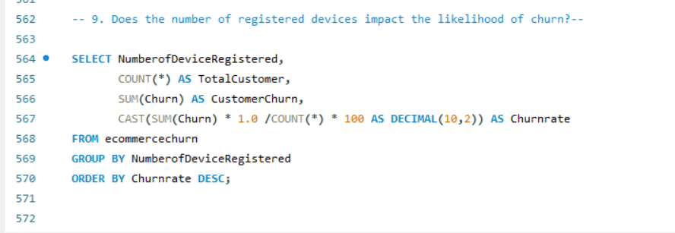
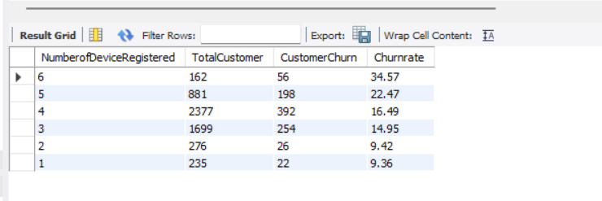
Q8.Does the number of registered devices impact the likelihood of churn?
There seems to be a correlation between the number of devices registered by customers and the likelihood of churn.
Customers with a higher number of registered devices, such as 6 or 5, exhibit higher churn rates.
On the other hand, customers with fewer registered devices, such as 2 or 1, show relatively lower churn rates.

Slide 11
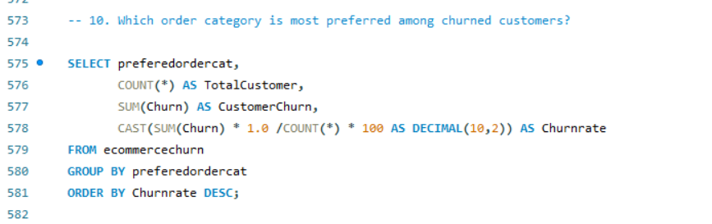
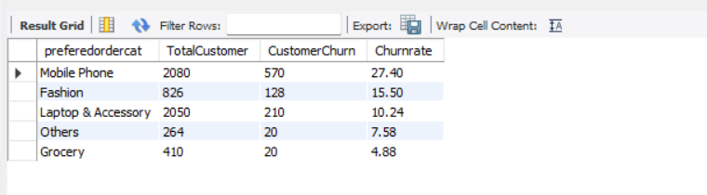
Q9.Which order category is most preferred among churned customers?
The analysis suggests that different order categories have varying impacts on customer churn rates.
Customers who primarily order items in the “Mobile Phone” category have the highest churn rate, indicating a potential need for targeted retention strategies for this group.
On the other hand, the “Grocery” category exhibits the lowest churn rate, suggesting that customers in this category may have higher retention and loyalty.

Slide 12
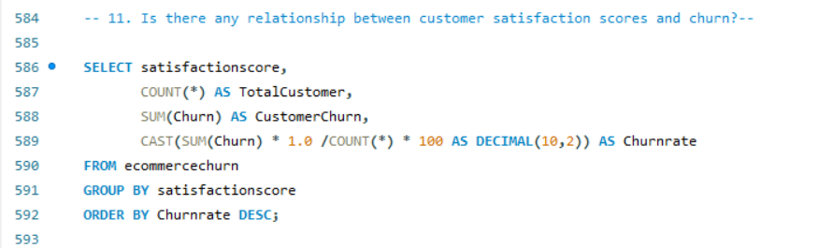
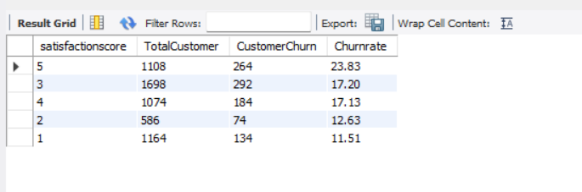
Q10. Is there any relationship between customer satisfaction scores and churn?
The result indicates that customers with higher satisfaction scores, particularly those who rated their satisfaction as 5, have a relatively higher churn rate compared to other satisfaction score categories.
This suggests that even highly satisfied customers may still churn, highlighting the importance of proactive customer retention strategies across all satisfaction levels.

Slide 13
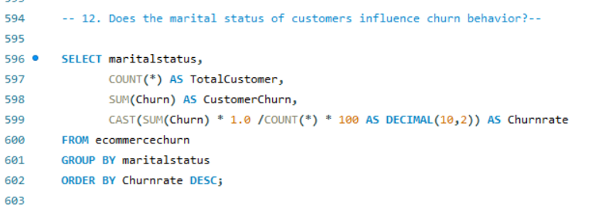
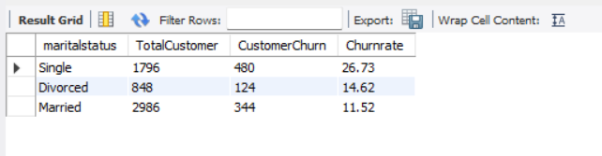
Q11. Does the marital status of customers influence churn behavior?
Single customers have the highest churn rate compared to customers with other marital statuses.
This indicates that single customers may be more likely to discontinue their relationship with the company.
On the other hand, married customers have the lowest churn rate, followed by divorced customers.

Slide 14
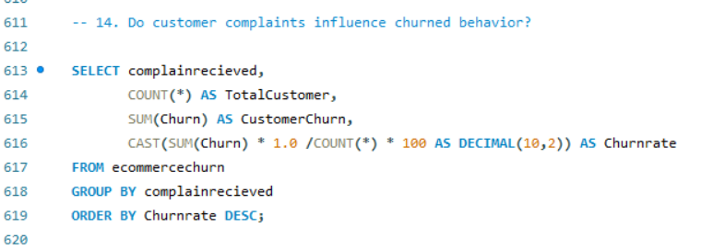
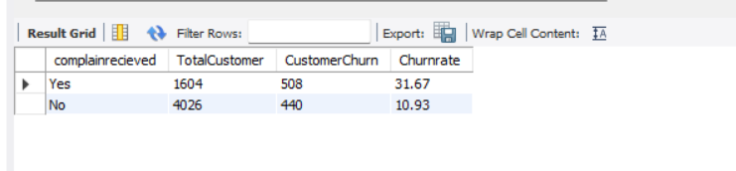
Q12. Do customer complaints influence churned behavior?
This is vital for decreasing the number of customers who leave and building lasting loyalty. By actively listening to customer feedback, addressing their issues, and consistently working on improving the quality of their offerings, companies can create a better overall experience for customers.
This approach helps to minimize the chances of customers leaving and fosters stronger relationships with them in the long run.

Slide 15
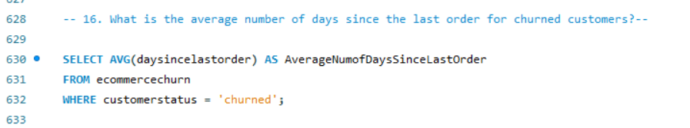
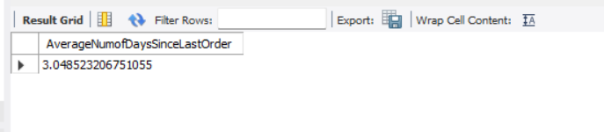
Q13. What is the average number of days since the last order for churned customers?
The fact that churned customers have, on average, only had a short period of time since their last order indicates that they recently stopped engaging with the company.
By focusing on enhancing the overall customer experience, implementing targeted retention initiatives, and maintaining continuous engagement, the company can work towards reducing churn and increasing customer loyalty.

Slide 16
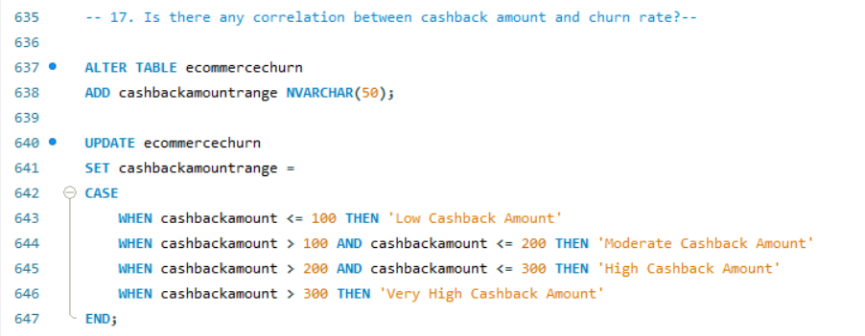
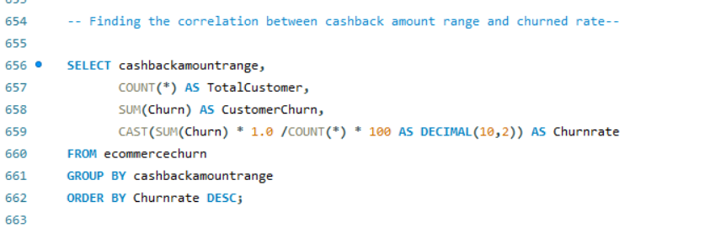
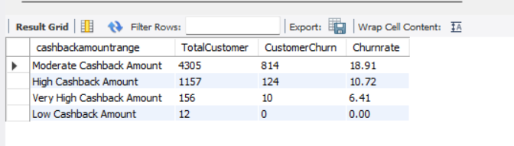
Q14. Is there any correlation between cashback amount and churn rate?
we will create a new column called “CashbackAmountRange” that groups the cashbackamount into low (less than 100), moderate (between 100 and 200), high( between 200 and 300), and very high (more than 300) using the CASE statement.
Customers who received moderate cashback amounts had a relatively higher churn rate, while those who received higher and very high cashback amounts exhibited lower churn rates.
Customers who received lower cashback amounts also had a 100% retention rate. This suggests that offering higher cashback amounts can positively influence customer loyalty and reduce churn.

Slide 17
Insight
The overall churn rate is 16.84%, indicating significant customer attrition.
Tier 1 cities have lower churn rates than Tier 2 and Tier 3 cities, possibly due to competition and customer preferences.
“Cash on Delivery” and “E-wallet” payment modes have higher churn rates, while “Credit Card” and “Debit Card” have lower churn rates, indicating the influence of payment preferences on churn.
Longer tenure is associated with lower churn rates, emphasizing the need for building customer loyalty early on.
Male customers have slightly higher churn rates than female customers, although the difference is minimal.
Moderate cashback amounts correspond to higher churn rates, while higher amounts lead to lower churn, suggesting the positive impact of higher cashback on loyalty.
Customer complaints are prevalent among churned customers, emphasizing the importance of addressing concerns to minimize churn.
Highly satisfied customers (rating 5) have a relatively higher churn rate, highlighting the need for proactive retention strategies at all satisfaction levels

Slide 18
Recommendations to reduce customer churn rate
Tailor retention strategies based on the different city tiers. Understand the preferences and needs of customers in each tier to provide targeted offerings and incentives that resonate with them.
Simplify payment processes, particularly for options like “Cash on Delivery” and “E-wallet.” Enhance security measures and offer incentives for customers to use more reliable payment methods such as “Credit Card” and “Debit Card.”
Improve customer support and complaint resolution. Address customer complaints promptly and effectively, providing satisfactory resolutions. Actively listen to customer feedback, make necessary improvements, and demonstrate a commitment to addressing their concerns.
Proactively engage and reward satisfied customers across all satisfaction levels. Regularly communicate with them through personalized messages, exclusive offers, and loyalty programs to maintain their loyalty and reduce the risk of churn.

Slide 19

- Thank You -

